Slide 1

CSE220 LAB
STACK VISUALIZATION
Prepared By: M. Shafiul Alam [SFA]

Slide 2

STACK
Stack Implementation using Python
elem
next
Operations:
push(elem)
pop()
peek()
isEmpty()
Node
Stack
top=None

Slide 3
STACK
push operation
elem
next
Operation:
push(elem)
Node
Stack
top=None

Slide 4
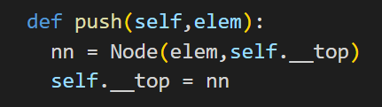
STACK
push operation
elem
next
Operation:
push(elem)
i.e push(15)
Node
Stack
top=None

Slide 5
STACK
push operation
elem
next
Operation:
push(15)
Node
nn
Stack
top=None

Slide 6
STACK
push operation
elem
next
Operation:
push(15)
Node
15
None
nn
Stack
top=None

Slide 7
STACK
push operation
elem
next
Operation:
push(15)
Node
15
None
nn
15
None
Stack
top=
15
None

Slide 8
STACK
push operation
elem
next
Operation:
push(15)
push(16)
push(25)
Node
15
None
Stack
top=
15
None

Slide 9
STACK
push operation
elem
next
Operation:
push(15)
push(16)
push(25)
Node
25
16
15
16
15
None
15
None
Stack
top=
25
16
16
15

Slide 10
STACK
pop operation
elem
next
Operation:
pop()
Node
25
16
15
16
15
None
15
None
Stack
top=
25
16
16
15

Slide 11
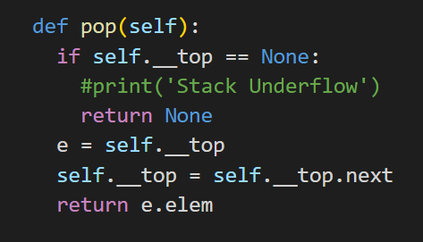
STACK
pop operation
elem
next
Operation:
pop()
Node
25
16
15
16
15
None
15
None
Stack
top=
25
16
16
15

Slide 12
STACK
pop operation
elem
next
Operation:
pop()
Node
25
16
15
16
15
None
15
None
Stack
top=
25
16
None?
16
15

Slide 13

STACK
pop operation
elem
next
Operation:
pop()
Node
25
16
15
16
15
None
15
None
Stack
top=
25
16
16
15

Slide 14
STACK
pop operation
elem
next
Operation:
pop()
e =
Node
25
16
15
25
16
15
16
15
None
15
None
Stack
top=
25
16
16
15

Slide 15
STACK
pop operation
elem
next
Operation:
pop()
e =
Node
25
16
15
25
16
15
16
15
None
15
None
Stack
top=
16
16
15
None

Slide 16
STACK
pop operation
elem
next
Operation:
pop()
e =
Node
25
16
15
16
15
None
15
None
Stack
top=
16
16
15
None

Slide 17
STACK
pop operation
elem
next
Operation:
pop() = 25
e =
Node
25
16
15
16
15
None
15
None
Stack
top=
16
16
15
None

Slide 18
STACK
peek operation
elem
next
Operation:
peek()
Node
16
15
None
15
None
Stack
top=
16
16
15
None

Slide 19
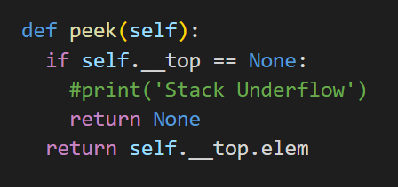
STACK
peek operation
elem
next
Operation:
peek()
Node
16
15
None
15
None
Stack
top=
16
16
15
None

Slide 20
STACK
peek operation
elem
next
Operation:
peek()
Node
16
15
None
15
None
Stack
top=
16
16
None?
15
None

Slide 21
STACK
peek operation
elem
next
Operation:
peek()
Node
16
15
None
15
None
Stack
top=
16
16
15
None

Slide 22
STACK
peek operation
elem
next
Operation:
peek() = 16
Node
16
15
None
15
None
Stack
top=
16
16
15
None

Slide 23
STACK
isEmpty operation
elem
next
Operation:
isEmpty()
Node
16
15
None
15
None
Stack
top=
16
16
15
None

Slide 24
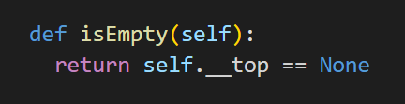
STACK
isEmpty operation
elem
next
Operation:
isEmpty()
Node
16
15
None
15
None
Stack
top=
16
16
15
None

Slide 25
STACK
isEmpty operation
elem
next
Operation:
isEmpty()
Node
16
15
None
15
None
Stack
top=
16
16
None?
15
None

Slide 26
STACK
isEmpty operation
elem
next
Operation:
isEmpty()
Node
16
15
None
15
None
Stack
top=
16
16
15
None

Slide 27
STACK
isEmpty operation
elem
next
Operation:
isEmpty() = False
Node
16
15
None
15
None
Stack
top=
16
16
15
None

Slide 28

LET’S CHECK
THE TASKS NOW!

